Slide 1



FreeDOM:
A Transferable Neural Architecture for Structured Information Extraction on Web Documents
Bill Yuchen Lin, Ying Sheng, Nguyen Vo, Sandeep Tata
*
* The work was done while BYL was a research intern at Google.
Notes:
Hi everyone, we are going to present our paper about a novel framework, FreeDOM, for structured information extraction on Web documents.
My name is Bill Yuchen Lin. I am currently a PhD student at the University of Southern California. And this work was done while I was working at Google as a research intern with my co-authors.

Slide 2
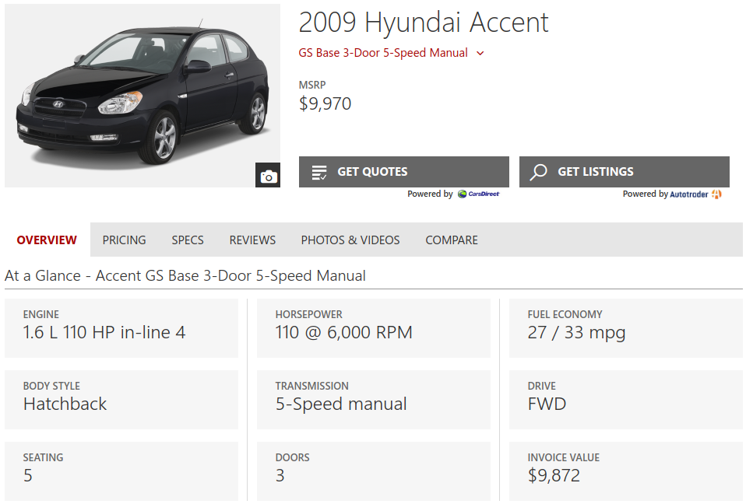

Task:
Information Extraction on Web Documents
Given a domain and a set of data fields.
Input: Web pages
Output: Structured data records
Downstream applications:
Knowledge Graph Construction
Question Answering
Recommendation System
etc.
Model | MSRP | Engine | Fuel Eco.
2009 H.. | $9,970 | 1.6 L … | 27/33 mpg …
Domain: Auto
Interested Fields:
Model
MSRP
Engine
Fuel Economy
1/14
Notes:
So, what is the task of Information extraction on web documents?
Given a domain like Auto-mobiles, and we are interested in a set of data fields
such as Model name, MSRP price, Engine info, and Fuel Economy data.
And we want to automatically extract such information from a large number of web pages of many different websites.
So, our input is a web page. Usually, it is called a detail page because it has a clear topic entity. For example, this car model.
The output is a structured data record that has the information we need.
Such data records can benefit a lot of downstream applications in data mining and machine learning.
For example, it can improve knowledge graph construction.
Then supports question answering,
And recommendation systems, And other applications

Slide 3
Key assumption: pages within a site have similar layout.
I have only A FEW websites of interest.
Develop and maintain rule-based matching programs (i.e. wrappers)!
Label some web pages, and train site-specific models via supervised learning (i.e., wrapper induction).
What if I have A LOT of unlabeled websites to process?
Building/training site-specific wrappers is time-consuming and expensive!
RQ: Can we learn a transferrable IE model?
2/14
Notes:
We do have a key assumption here. That is, pages within the same website have very similar layouts.
Therefore, the problem would be easier if we have only a few website of interest.
We can develop and maintain rule-based programs for matching the data record in the page, which we called wrapper programs. They can be simple regular expressions or python scripts.
Or, if the layout can be different across pages, or you want to save the human efforts of writing programs, then you can also label some pages and train site-specific models via supervised machine learning. (We call this process as wrapper induction).
Both methods are effective when we are processing only a small number of sites.
What if you have a lot of unlabeled, unseen websites to process?
The task would be much more challenging.
Because building or training site-specific wrappers will be much more time-consuming and expensive. Thus, they are not scalable.
Then, our research question in this paper is how we can learn a transferrable IE model that can learn from a few sites and generalize to many unseen sites.

Slide 4








Problem formulation
A motivating example: building a course KB.
Name
Domain: course
Fields: Name, Course Number, Instructor, Time, Location, Email, Textbook, Description
Course Number
Instructor
Time
A few labeled seed websites.
Location
Email
Description
MIT
Harvard
USC
…..
Textbook
Detail
Pages
A particular detail page w/ labels
3/14
Notes:
Before we dive into our framework, we would like to use a motivating example of building a course-information knowledge base,
to illustrate the learning scenario that we are going to solve in this paper.
So our domain is course.
And we are interested in a few data fields including name, course number, instructor, time, location, email, textbook, description.
We have only a few labeled seed websites, for example MIT, Harvard, USC.
And in each site, we have a bunch of detail pages, like this one.
Because they are seed websites for training, we have labels for them.

Slide 5





Problem formulation
A running example: building a course info KB.
Learning to Generalize for
Unseen Websites
Many unseen websites, w/ different layouts
Test
Univ. 1
Univ. 2
Univ. 3
Univ. 4
A few labeled seed websites.
…..
Training
Univ. 5
Univ. 6
Univ. 7
MIT
Harvard
USC
A Transferable Model
A Course Information Knowledge Base
Post-processing
4/14
Notes:
Our goal in this paper is to train a transferable model
That can directly work on extracting data from many unseen websites, where they have very different layouts.
So the wrapper induction is not suitable here.
Finally, the model can be used for populating a knowledge base for downstream applications.

Slide 6
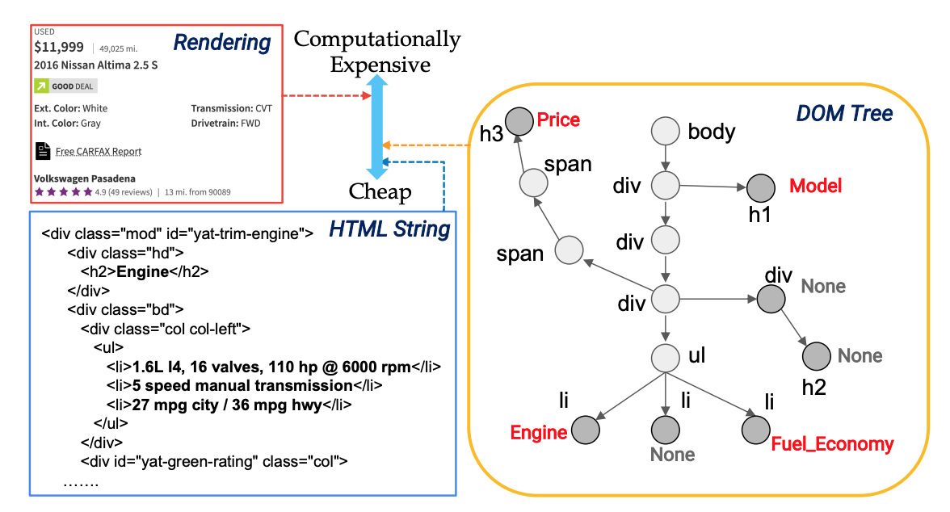
Problem formulation
Information Extraction
as DOM node classification
How to represent a web page
Rendering
MSRP
DOM Tree
HTML Code
Node labels:
Model
MSRP
Engine
Fuel_Eco.
None
5/14
Notes:
You many wander how we can encode a web page for a machine learning model to extract information.
People usually have three choices.
The first one is based on browser rendering, which has the most comprehensive information.
But, we need to download all the external resource files like images, CSS style files, and even java scripts for the page.
This would be most computationally expensive.
On the contrary, we can also only use the plain source HTML code to extract the information, while it turns out to be very difficult since we lose a lot the structural info.
We therefore take the parsed DOM trees as the representations of the web pages. Parsing DOM tree isn’t that expensive, and does not need external resources.
Also, we have the key structures that can help us extract the data we want.
Thus, the problem of information extraction on web documents becomes the problem of classifying each DOM node into a set of types.
This is the space of the node labels. The first four are the value types. We have a special label “None” here for the DOM nodes where no interested values is inside.

Slide 7
Overview of FreeDOM:
A Two-Stage Framework
6/14
Notes:
Our proposed FreeDOM is a two-stage framework.
The model only requires a very small number of seed sites for training.
The first learning stage is for encoding each node on the DOM trees for embedding many raw features in the pages.
The second stage further encodes dependency between DOM nodes by modeling their pairwise relational features.
Finally, we can predict the label of each DOM node in the page and thus extract the data we want.
Our model achieves the state-of-the-art performance on the public SWDE dataset. The proposed FreeDOM outperforms baseline methods with a large margin, without even using any expensive rendering-based features.

Slide 8
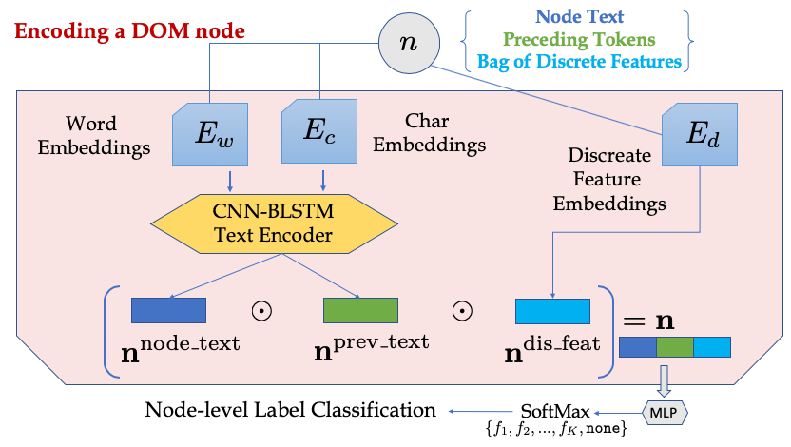

FreeDOM: (1) Learning to encode a DOM node
“Elements of …..”
“Textbooks:”
{node_type: div, contain_url: 1, contain_digits: 0, etc. }
E
l
e
…
Elements
of
Statistical
…
Char.
Emb.
CNN
Word Embeddings
BLSTM
Mean
Pooling
{Name, Course Number, Instructor, Time, Location, Email, Textbook, Description, None}
7/14
Notes:
We now introduce our first stage model.
You can see here is the previous example. And if we only look at this particular part of the page. We should be able to know this DOM node is the textbook value by the node itself, right?
Our model uses three sources of the raw features to learn this ability.

Slide 9


Problems of Only Using
Node Representations
Similar
Dependency
Time
Location
Description
Time
Textbook
Location
A page in the training seed sites
Misleading Local Node Features
Description
Weak Local features
Textbook
A page from an unseen site at test time
8/14
Notes:
Although the first stage model itself can already predict the labels of the DOM nodes and extract the data record from the page.
However, we found the predictions are sub-optimal because the first stage model does not make use of the node dependency for predictions.
Then, some local node features can be misleading.
For example,

Slide 10
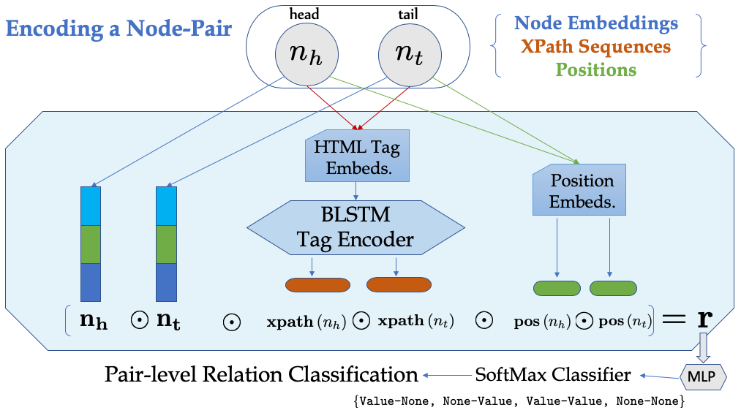
FreeDOM: (2) Learning to encode dependency
via pair-wise modeling!
XPath (i.e., a sequence of html tags):
[“<html>”, “<body>”, “<div>”, “<ul>”, “<li>”].
Position embedding: integer2vec
n₁
n₂
n₄
n₃
n₅
Relation(n₁, n₂) = Value-Value
Relation(n₂, n₃) = Value-None
Relation(n₃, n₄) = None-Value
Relation(n₃, n₅) = None-None
Aggregating scores for node labeling (based on Stage 1)
9/14
Notes:
Therefore, we propose learning to encode node dependency through pair-wise modeling.

Slide 11
Pre/Post-Processing Tricks
Too many nodes?
Too many node-pairs?
Site-level constraints?
Variable nodes (with the same XPath) have different contents across different pages. Thus, we can ignore nodes that are common boilerplate, such as navigation bars, headers, footers, etc.
Uncertain fields. We can only look at the node pairs about the most plausible m nodes that are ranked top by the first-stage node classifier.
Majority voting XPath-Fields patterns within each site, for avoiding outlier predictions.
10/14

Slide 12
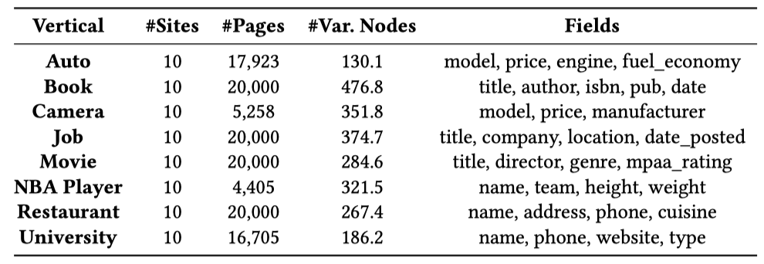
Experiment Set Up
The statistics of the SWDE dataset (Hao et al. in Proc. of SIGIR 2011).
K for training (i.e., seed source sites)
10-K for test (i.e., target sites)
10 cyclic permutations → Average Performance
11/14

Slide 13
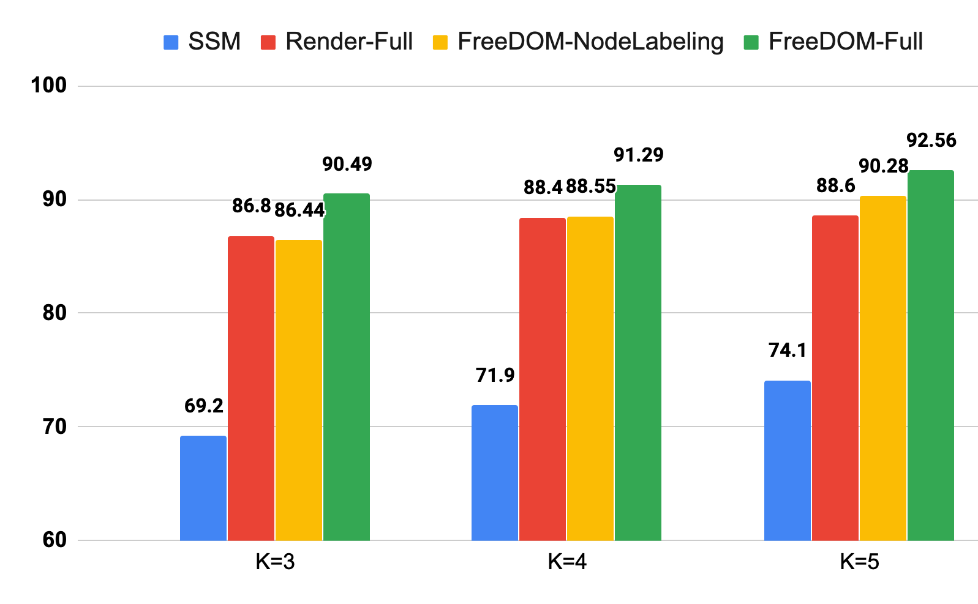

Experimental Results on SWDE dataset
Rendering +
Handcrafted Heuristics
12/14
Notes:
This is the main experiment. We are mainly looking at two typical baseline methods.
The SSM was proposed by the authors of the SWDE dataset as a conventional ML methods based on the DOM tree alignment with hand-crafted features.
The Render-Full is using the rendered results from the browser and use a lot of handcrafted features and complicated heuristics for using the visual distance as features for prediction.
Our model achieves the state-of-the-art performance on the SWDE dataset, with a large margin comparing to the two baselines.
But, we don’t use any expensive rendering-based features.

Slide 14
Ablation Study:
First Stage+ Different Node Tagging Models
13/14
Notes:
Some may be interested what if we don’t use our proposed second stage model, but use other options.
So we tried four alternatives: BLSTM, CNN, BLSTM-CRF, and CNN-CRF on the top of our first stage model, which we denote as node labeling (NL).
Even if we don’t use any discrete features, our model is still quite powerful, which means the neural representation is the most effective part.

Slide 15
Conclusion
We present a novel neural architecture, FreeDOM, for transferrable information extraction on web docs.
Expensive rendering is not necessary, as FreeDOM can encode the node dependency via pairwise modeling.
FreeDOM achieves a new state-of-the-art on the SWDE dataset while not using any hand-crafted features or complex heuristic algorithms.
Future Directions based on FreeDOM
Open Information Extraction?
Self-supervised pre-training for HTML documents?
14/14

Slide 16
Thank You!

